Slide 1

Restoring Harmony: When Facilities Overshadow Relationships
In any thriving community, the balance between physical infrastructure and the strength of interpersonal connections is paramount. This presentation explores a common challenge: when the focus on tangible assets inadvertently erodes the social fabric, leading to discord. We will delve into the principles of conflict transformation and propose a practical method to mend these ruptures, ultimately fostering a more cohesive and resilient community.

Slide 2

The Conflict: Facilities vs. Relationships
Misplaced Priorities
Erosion of Trust
Many communities, with the best intentions, invest heavily in physical infrastructure. New community centres, upgraded sports facilities, or renovated public spaces are often seen as markers of progress and prosperity.
However, this intense focus on tangible assets can inadvertently lead to the neglect of interpersonal connections and social dynamics. When relationships are not nurtured, a vacuum forms, often filled with mistrust and division.
Fragmented Community
The unfortunate result is escalating conflicts among community members, a breakdown in communication, and a fragmented community spirit where collaboration is difficult and grievances fester. The very facilities meant to unite can become points of contention.

Slide 3
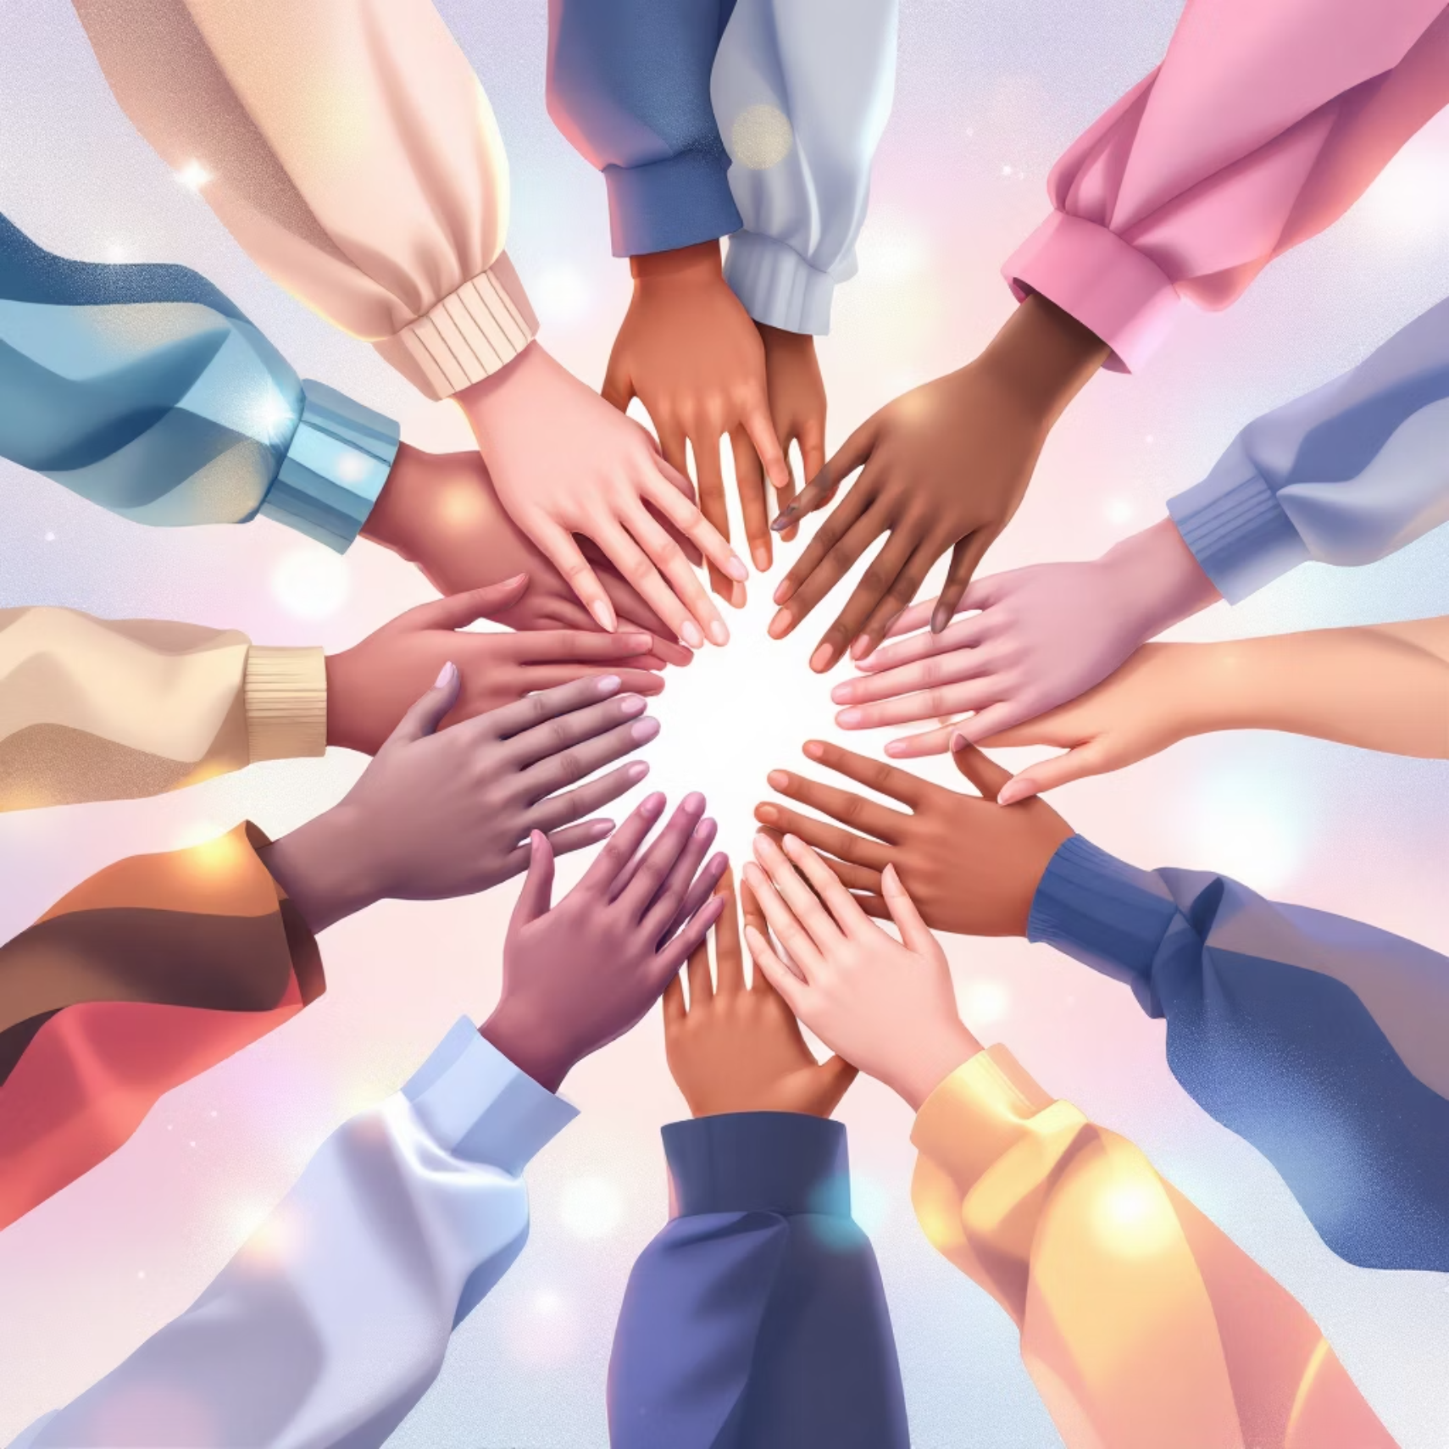

Why Relationships Matter More Than Facilities
While well-maintained facilities certainly contribute to quality of life, they are merely tools. The true strength and resilience of a community lie in the quality of its relationships.
Beyond Bricks and Mortar
Resilience and Problem-Solving
Facilities alone cannot build the foundational trust or foster genuine cooperation needed for a harmonious community. Without strong bonds, these spaces can feel impersonal or even become battlegrounds for competing interests.
Robust relationships are the bedrock of community resilience. They enable collective problem-solving, facilitate mutual support during challenging times, and ensure that diverse voices are heard and valued.
When connections are weak, even the most impressive facilities can become symbols of division or sources of ongoing tension, rather than catalysts for unity and shared progress.

Slide 4

Introducing Conflict Transformation Principles
1
2
Conflict as a Process
Focus on Root Causes
Conflict is an inherent and often healthy part of human interaction, not just an isolated event. It represents an opportunity for growth and deeper understanding.
Conflict transformation seeks to address the underlying issues, perceptions, and relational dynamics that fuel disputes, moving beyond mere symptom management.
3
4
Sustained Engagement
Lasting Peace
This approach demands ongoing, non-violent engagement with all parties involved, fostering an environment where empathy and active listening can flourish.
The ultimate goal is to shift attitudes, behaviours, and structural inequalities, paving the way for sustainable peace and a more just community.

Slide 5






The Power of Restorative Circles
Restorative circles offer a powerful, community-based approach to conflict resolution, focusing on healing and rebuilding relationships rather than simply assigning blame.
Talking Piece Protocol
Egalitarian Voice
The use of a talking piece (an object passed around the circle) ensures disciplined listening and thoughtful speaking, preventing interruptions and promoting deeper reflection.
Circles are designed to be inclusive, ensuring every individual has an equal opportunity to speak and be heard, fostering a sense of belonging and respect.
Building Empathy
By creating space for personal narratives and shared experiences, circles naturally cultivate empathy, allowing participants to understand different perspectives and feelings.
Healing and Rebuilding
Restorative circles are proven tools for mending ruptured relationships, healing emotional wounds, and rebuilding the social fabric of a community, transforming conflict into connection.
Shared Responsibility
Participants collectively explore how harm has occurred and what is needed to repair it, fostering a sense of shared responsibility for the well-being of the community.

Slide 6
Step 1: Create Safe Spaces for Dialogue
The first crucial step in restoring harmony is establishing environments where community members feel secure enough to express their true feelings and concerns without fear of reprisal.
Prepare Thoughtful Questions
Organise Regular Circles
Develop open-ended questions that encourage reflection rather than accusation. Focus on 'what happened,' 'who was affected,' and 'what is needed to make things right,' rather than 'who is to blame.'
Initiate a series of restorative circles, carefully inviting a diverse cross-section of the community. Ensure representation from all groups affected by the conflict.
Trained Facilitation
Emphasise Core Values
Ensure circles are led by trained facilitators who can maintain neutrality, guide discussions, and uphold the integrity of the process, making everyone feel safe and heard.
Clearly articulate the foundational principles for the circle: respect, honesty, humility, and inclusiveness. These values are non-negotiable for a safe and productive dialogue.

Slide 7


Step 2: Foster Open Communication & Active Listening
Effective communication is the cornerstone of conflict resolution. It moves beyond superficial exchanges to delve into the heart of shared human experience, requiring both bravery to speak and discipline to listen.
Share Personal Stories
Practice Active Listening
Encourage participants to share their personal stories, experiences, and feelings related to the conflict. This humanises the issues and helps break down abstract barriers.
Cultivate a culture where active listening is paramount. This means listening not just to respond, but to genuinely understand. Participants should listen without interruption, judgement, or planning their own rebuttal.
When individuals articulate how they have been personally impacted, it transforms the conflict from an impersonal issue into a shared human experience.
The goal is to absorb the other's perspective fully, which involves paying attention to both verbal and non-verbal cues.
"The biggest communication problem is we do not listen to understand. We listen to reply."
Validating feelings and perspectives, even if one doesn't agree with them, is crucial for building mutual understanding and trust. It signals that every voice matters.

Slide 8




Step 3: Identify Shared Values and Common Goals
Moving beyond the immediate grievances, this step focuses on uncovering the deeper, unifying elements that can bring a community together, shifting the focus from division to shared aspirations.
Collective Well-being
Compatible Needs
Shift the conversation from debates about specific physical assets to the overarching goal of collective well-being and community harmony. What kind of community do we all want to live in?
Facilitate discussions that highlight compatible needs and aspirations rather than focusing solely on opposing interests. Often, diverse groups share fundamental desires for safety, belonging, and opportunity.
Shared Future
Co-create Agreements
Encourage participants to envision a future where both excellent facilities and strong, trusting relationships coexist harmoniously, benefiting everyone.
Work collaboratively to co-create new community agreements or principles that explicitly prioritise relationships alongside the development and maintenance of facilities. These agreements serve as a social contract.

Slide 9
Step 4: Sustain Engagement and Collaborative Action
Restoring harmony is not a one-time event but an ongoing process. This final step outlines strategies for embedding these practices into the community's fabric, ensuring lasting positive change.
Continuous Dialogue
1
Establish permanent or semi-permanent restorative circles or forums that meet regularly. These can serve as safe spaces for ongoing dialogue, preventing minor issues from escalating into major conflicts.
2
Inclusive Decision-Making
Integrate all stakeholders into decision-making processes, particularly concerning new facilities or community projects. Ensure that voices from all segments of the community are genuinely heard and considered.
Conflict Coaching
3
Introduce conflict coaching principles to empower individuals with the skills to manage disputes constructively in their daily lives. This builds individual capacity for peaceful interaction.
4
Celebrate Progress
Regularly acknowledge and celebrate successes, no matter how small. This reinforces positive behaviours and encourages continued participation in community-building efforts.

Slide 10

Conclusion: From Conflict to Community
By intentionally prioritising relationships, a community can transform moments of conflict into powerful opportunities for growth and deeper connection. Facilities, while important, truly serve their purpose when underpinned by robust and inclusive community bonds.
"We build not just structures, but a connected, resilient community."
Embracing conflict transformation principles and consistently utilising restorative circles allows for the restoration and sustained maintenance of harmony. This journey fosters a vibrant social fabric where mutual respect, understanding, and shared responsibility flourish.

